Slide 1
Principles of Data Science
Li Niu

Slide 2
Data Visualization
Scatter plot
Line graph
Chart
Box plot
High-dimension

Slide 3
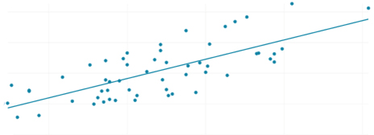
Scatter plot
weight and height of children
weight (lb)
140
120
100
80
60
56 60 64 68 72
height (in)

Slide 4
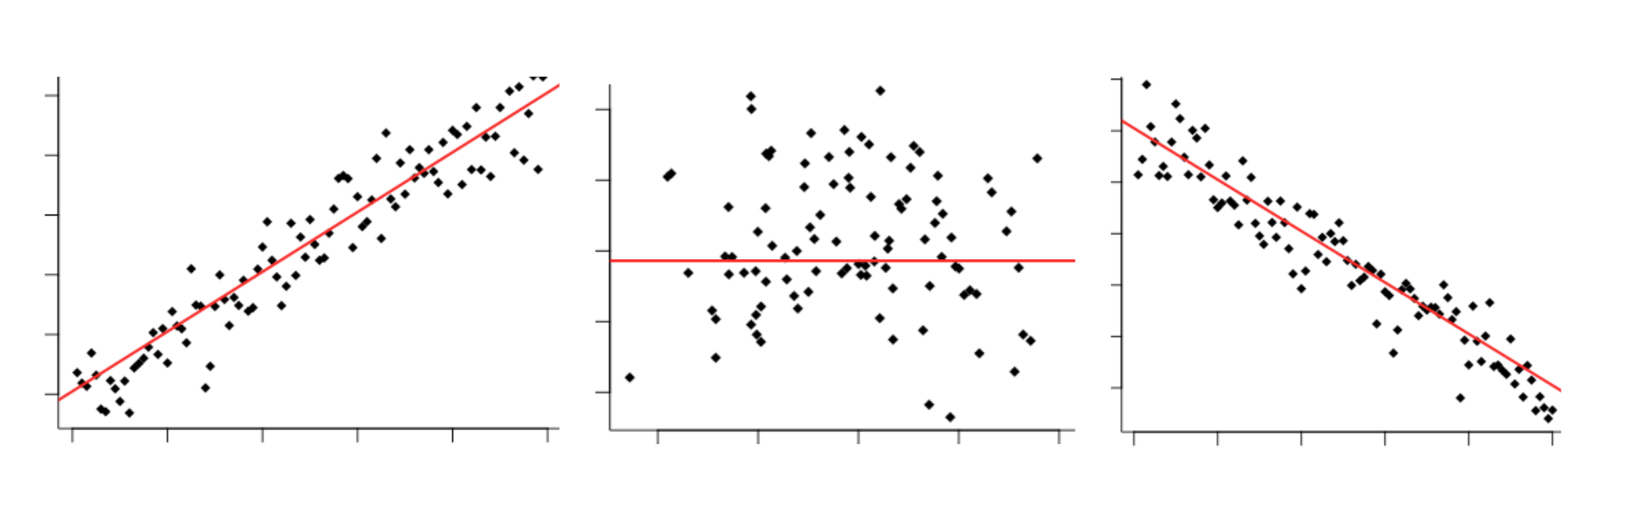


Scatter plot
positive correlation
no correlation
negative correlation
grade
grade
grade
study time
body weight
game time

Slide 5
Data Visualization
Scatter plot
Line graph
Chart
Box plot
High-dimension

Slide 6
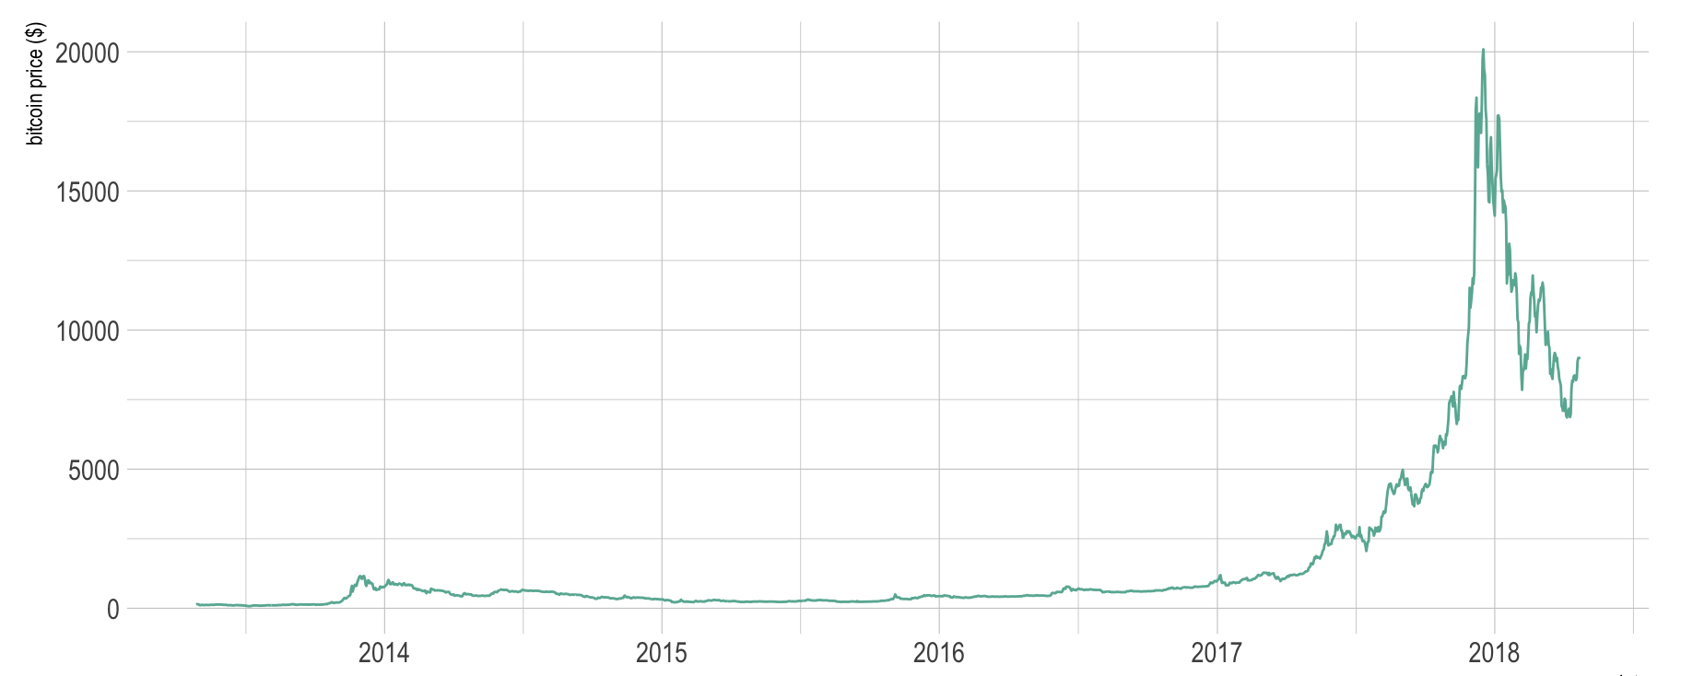
Line graph
bitcoin price

Slide 7
Data Visualization
Scatter plot
Line graph
Chart
Box plot
High-dimension

Slide 8
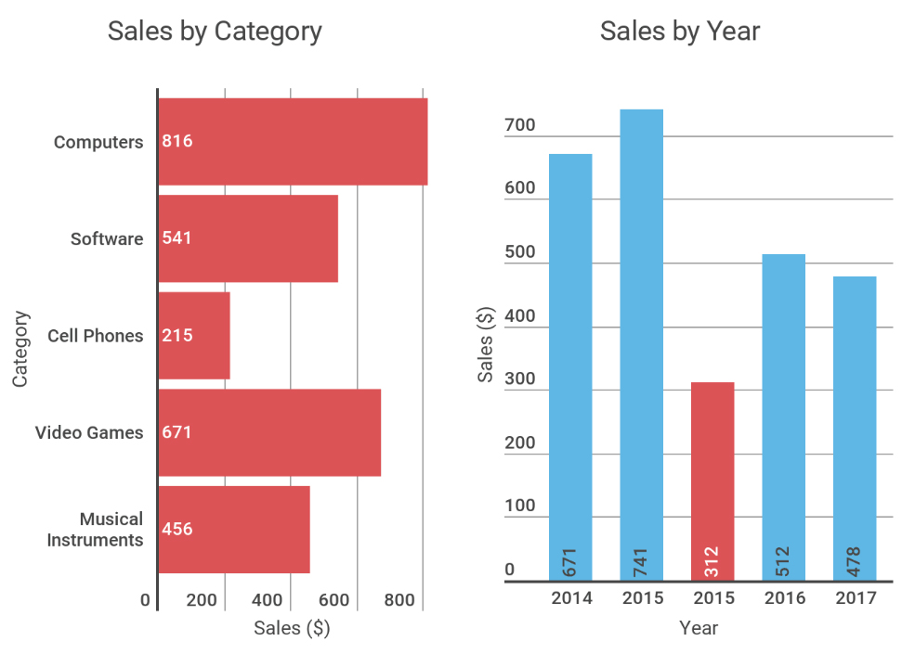
Chart
Bar chart
Bar chart

Slide 9
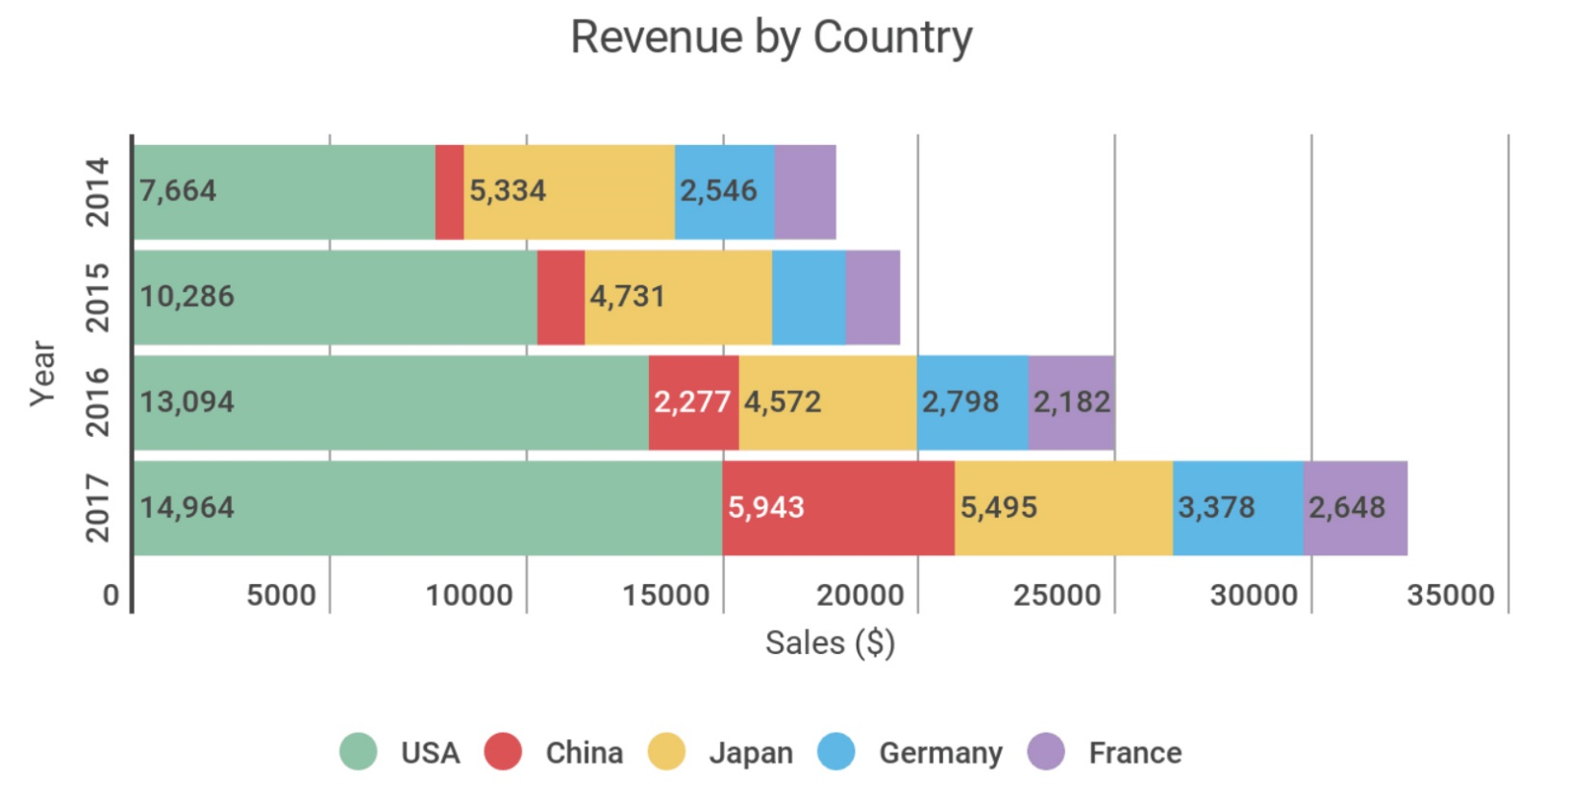
Scatter plot
Stacked bar chart

Slide 10
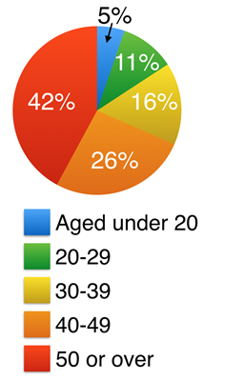
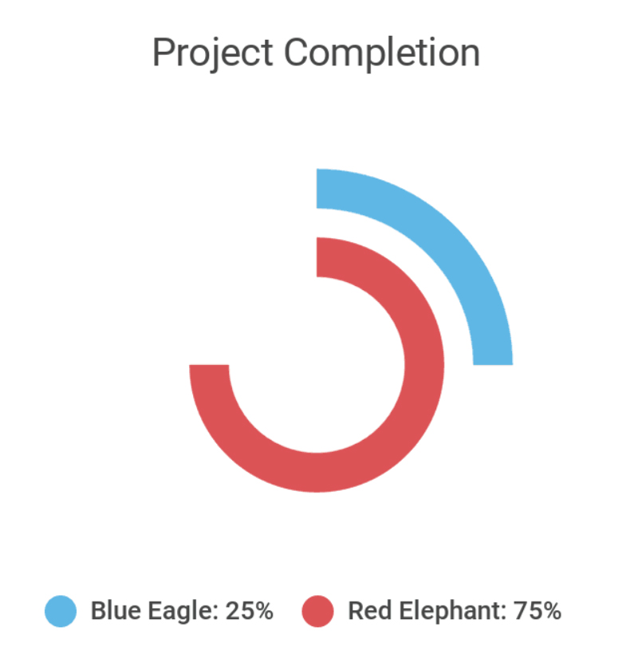
Chart
Pie chart
Radial chart

Slide 11
Data Visualization
Scatter plot
Line graph
Chart
Box plot
High-dimension

Slide 12
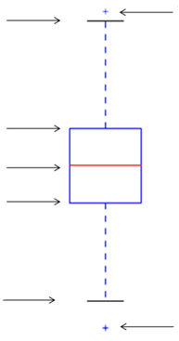
Box plot
100%
outlier
75%
50%
25%
0%
outlier

Slide 13
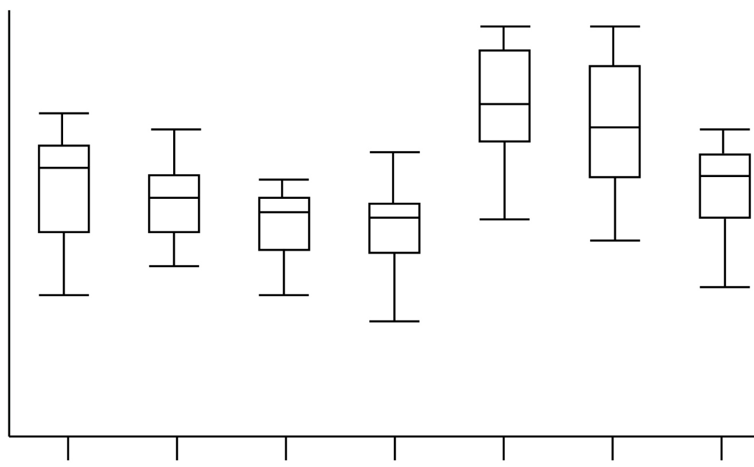
Box plot
Sleeping time (hours)
12
11
10
9
8
7
6
5
4
3
2
1
0
Mon Tues Wed Thu Fri Sat Sun

Slide 14
Data Visualization
Scatter plot
Line graph
Chart
Box plot
High-dimension

Slide 15
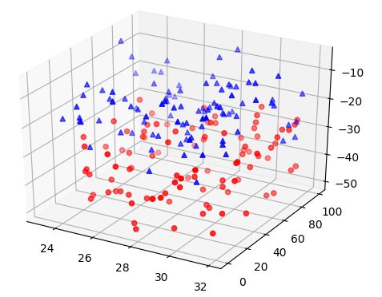
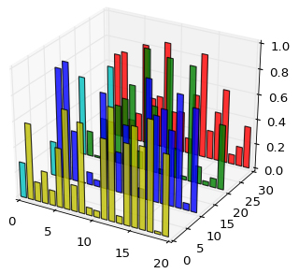
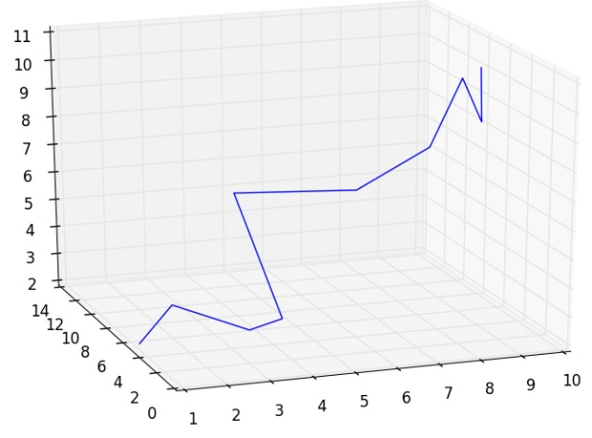
3D visualization
3D scatter plot
3D line graph
3D chart

Slide 16
Beyond 3D Visualization
….

Slide 17
Beyond 3D Visualization
Project high-dim data to lower dim
….

Slide 18
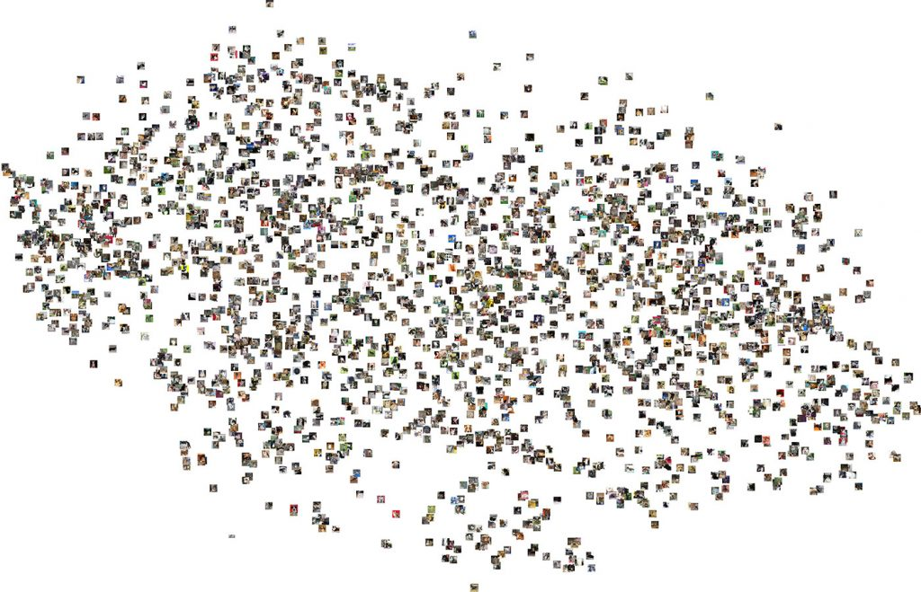
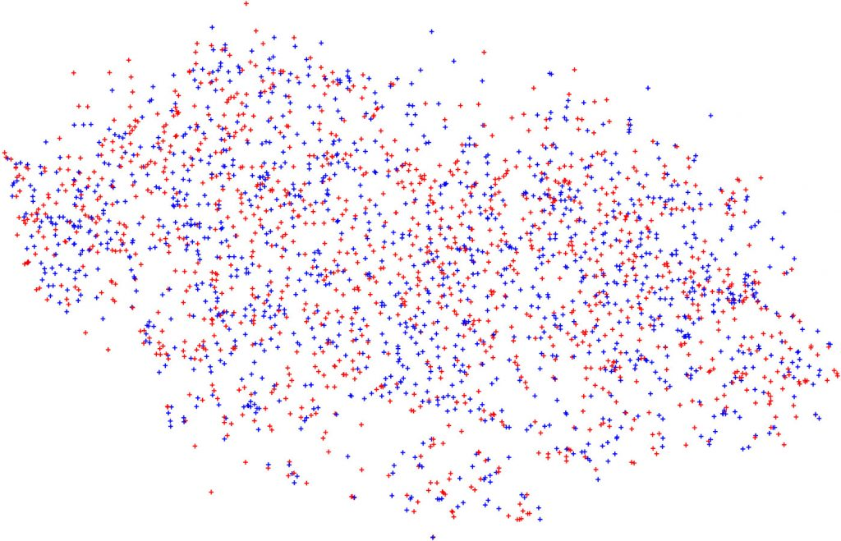
Beyond 3D Visualization
t-SNE: project high-dim features into 2-dim for ease of visualization
t-SNE visualization of cat and dog images

Slide 19
Thanks!

